Slide 1
Time complexity / Big-O notation
Analysis of algorithms

Slide 2
Time complexity
An introduction to time complexity and Big-O notation can be found in the "Sorting" powerpoint (AP CS folder). In this presentation, we'll take a deeper look at the various types of time complexities and how to evaluate the Big-O of a particular algorithm.
The descriptions of the different types of time complexities are borrowed from the excellent site corejavainterviewquestions.com/idiots-guide-big-o.
The different types are presented in order, from fastest to slowest (relative to how they scale with larger data sets).

Slide 3
What is Big-O???
Big-O notation is used to describe the performance (the run time) of a function or algorithm in terms of how quickly the run time grows relative to the input, as the input gets arbitrarily large.
Big-O specifically describes the worst-case scenario, and can be used to describe the execution time required or the space used (e.g. in memory or on disk) by an algorithm.
Big-O is an asymptotic notation, meaning it's the behavior a function gravitates towards for infinitely large data sets.

Slide 4
The different time complexities
O(1) / Constant Complexity: Constant time. This means that, regardless of the size of the data set, the algorithm will always take the same amount of time.
1 item takes 1 second, 10 items takes 1 second, 100 items takes 1 second.
It always takes the same amount of time!
This is the best possible outcome, obviously, and is generally only possible with some very specialized data and very specialized data structures.

Slide 5
The different time complexities (cont'd)
O(log n) / Logarithmic Complexity: Not as good as constant, but still really good! The time taken increases with the size of the data set, but not proportionately so.
The algorithm takes longer (per item) on smaller datasets relative to larger ones.
1 item takes 1 second, 10 items takes 2 seconds, 100 items takes 3 seconds.
Also very good! Binary search is the classic example – as data sets get larger, an O(log n) function doesn't take significantly longer, due to its 'divide and conquer' approach.

Slide 6
The different time complexities (cont'd)
O(n) / Linear Complexity: The larger the data set, the time taken grows proportionately.
1 item takes 1 second, 10 items takes 10 seconds, 100 items takes 100 seconds.
Still not bad! The classic example is a linear search – as the list gets longer, the number of steps required (in the worse case) gets larger, in a linear fashion.

Slide 7
The different time complexities (cont'd)
O(n log n): A combination of O(n) and O(log n). Normally there's 2 parts to a sort: the first step is O(log n), the second is O(n), combining to form O(n log n).
1 item takes 2 seconds, 10 items takes 12 seconds, 100 items takes 103 seconds.
Still pretty good! The classic example is a merge sort; similar to binary search, dividing the arrays is an O(log n) operation, while putting them back together is an O(n) operation, hence the O(n log n) time complexity.
Note that the n and the log n component are not constant, and are both of the same order, thus neither part can be ignored.

Slide 8
The different time complexities (cont'd)
O(n²) / Quadratic Complexity: Things are slowing down.
1 item takes 1 second, 10 items takes 100 seconds, 100 items takes 10000 seconds.
Any type of sort / operation that has nested loops, where, for each iteration of the outer loop, the inner loop has to run n times, will have an n² time complexity. Pretty slow for large data sets!
Note: n to the power of anything, i.e. n^{x}, is referred to as "polynomial complexity". n³ will of course be slower than n², but faster than 2^{n}.

Slide 9
The different time complexities (cont'd)
O(2^{n}) / Exponential Growth: Getting really slow! The algorithm takes twice as long for every new element added.
1 item takes 1 second, 10 items takes 1024 seconds, 100 items takes 1267650600228229401496703205376 seconds.
Generally a sign of bad programming, usually restricted to very naïve operations / novelty sorts or an algorithm that badly needs optimization.

Slide 10
The different time complexities (cont'd)
O(n!) / Factorial growth: Don't.
1 item takes 1 second, 10 items takes 362880 seconds, 100 items takes unbelievably long.
Pretty much restricted to novelty sorts like the Random Sort, you have to plan ahead to be this bad.

Slide 11
The different time complexities (cont'd)

Slide 12
Why O(log n)???
Unless you are an accomplished mathematician, you might be wondering why binary search has a Big-O of O(log n), and why merge sort has an O(n log n) time complexity.
Both of these algorithms use a 'divide and conquer' approach. The data set is divided in half each iteration.
In other words, if there are n terms in the data set, the next time it runs there will be n/2 terms to consider*.
*Technically it will be n/2 – 1, however with Big-O, constants are discarded, as when the data set gets infinitely larger, they become infinitely more irrelevant.

Slide 13
Why log n??? (cont'd)
Each iteration of the search, the data set that's being processed will get smaller and smaller, like this:
n
n/2
(n/2) / 2
((n/2) / 2) / 2
This can be generalized like this:
n / 2^{k}
In other words, if you divide the data set each iteration, it will be divided by two k number of times.

Slide 14
Why log n??? (cont'd)
The algorithm is going to run (worst case) until the data set has just one element left. At this point, you've either found the key or you return -1.
In other words, reducing the data set to 1 element is the goal, and this process will take (at worst) n / 2^{k} number of iterations. In math terms:
n / 2^{k} = 1 (n elements, divided by 2 k number of times, until n == 1)
Trivially solving for n, we get 2^{k} = n. Take the log (inverse exponent) of both sides to allow us to simplify the expression even further...
log(2^{k}) = log(n) logs allow us to factor out the k…
k * log(2) = log(n) divide both sides by log(2) (a constant)…
k = log(n) / log(2) and magically we find...
k = log₂(n)

Slide 15
Why log n??? (cont'd)
Remember that k was the term that represented how many times the data set was being divided by 2, until our goal of having only 1 element remaining was reached (in the worst case).
Given what we found on the previous slide (k = log₂(n)), it can be seen that for n number of elements, it will take log₂(n) number of iterations to reach just one element remaining.
Given that log base-2 is the same as log base-10 multiplied by some constant factor, and constants in Big-O are ignored (as n gets infinitely large, constants are infinitely irrelevant), we can technically ignore the log's base.
There we have it, binary search is O(log n)!

Slide 16
Why log n??? (cont'd)
Merge sort is kind of a combination of binary search and a linear search. The merge sorting (the recursive call of mergeSort()) takes log(n) time, as it's a 'divide and conquer' approach.
Putting the merge-sorted arrays back together takes n operations, hence the O(n log(n)) time complexity.
As n and log(n) are both of the same order and neither are constant, neither can be discarded*.
*For an algorithm with a time complexity of something like n³ + n² (an n³ and n² operation), only the highest order monomial is considered. Lesser order monomials are ignored, hence the n³ + n² function would have a Big-O of O(n³).

Slide 17
A VERY brief intro to limits
Limits are a topic that, if you take a calculus course, you'll probably spend a couple months on.
Let's grossly oversimplify them in a few slides!
For some number N, the expression 1 / N will eventually converge on 0 for infinitely large values of N. Think about it:
1 / 2 == 0.5
1 / 5 == 0.2
1 / 10 == 0.1
1 / 100 == 0.01
1 / 1000 == 0.001
1 / <some huge number> == really ("infinitely") close to 0

Slide 18

A VERY brief intro to limits (cont'd)
In more calculus-like limit notation:
As X approaches infinity, 1 / X approaches 0. Keep that in mind!
This is the explanation of why "lower-order" terms (terms with a smaller exponent) are ignored when determining Big-O. Example:
f(x) = x⁴ + x³ + 5
For "infinitely" large values of x, the constant (5) and the x³ term become infinitely smaller than the x⁴ term.
Lower-order terms are infinitely more irrelevant for infinitely large values of x.

Slide 19
Big-O quick guide
Given a data set with N elements...
The following tips will help in quickly determining the Big-O of a particular algorithm:
1. Nested loops' N must be multiplied.
2. Sequential loops' N are added (e.g. O(m + n))
3. Only the highest-order term is "relevant".
4. Constants are ignored.

Slide 20
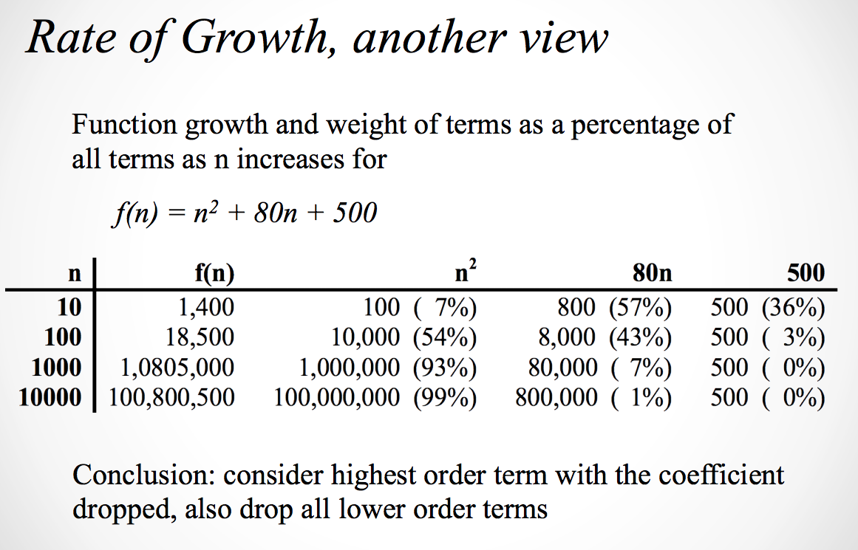
Why do we drop lower order terms?
Consider a function f(n) defined as follows:

Slide 21
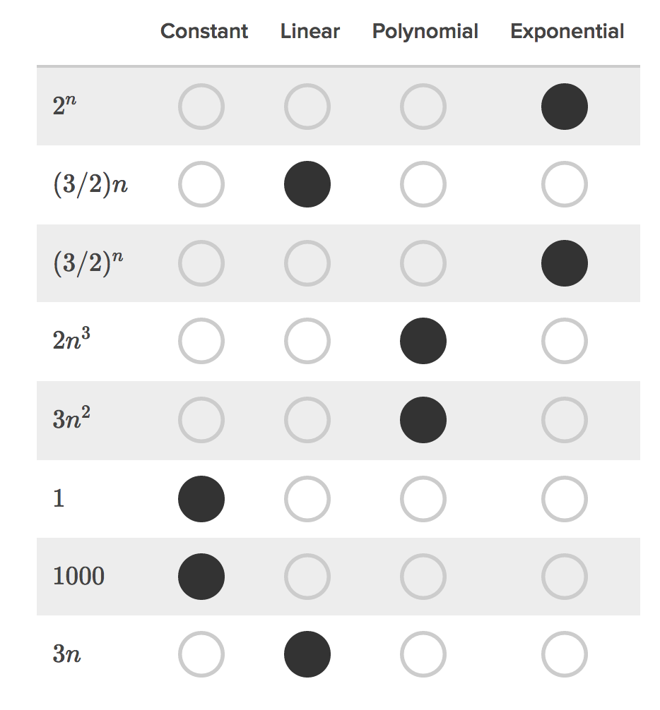
Big-O quick guide (cont'd)

Slide 22
Big-OhhhhhhhhMG
Over time, considering time complexity when designing an algorithm will become second nature. However, it's generally not good practice to over-optimize an algorithm if it hurts the readability of the code.
Professional programmers generally spend a lot more time working with others' code and/or supporting old code than they do writing code from scratch.
A fantastically fast algorithm you won't be able to understand in a couple days is not useful, and will annoy other programmers!

Slide 23
Other performance metrics
Big-O is a description of how an algorithm responds to an increase in sample size for a worst case scenario; big-O does not care that Bubble Sort can be really fast in certain circumstances.
There are several other performance metrics that refer to how an algorithm responds in other cases.
For example, Big Theta is (generally speaking) the average case (mathematically speaking, a tight asymptotic upper and lower bound).

